Slide 1
Progess of the Project
Tsung-Min Pai
2023/11/17

Slide 2
Outline
GNN
Experiment
Recap
Observe the distribution of the prediction
Remove the predictable TTP from the dataset
Paper
GraphSMOTE
Future Work

Slide 3
Experiment - Recap

Slide 4
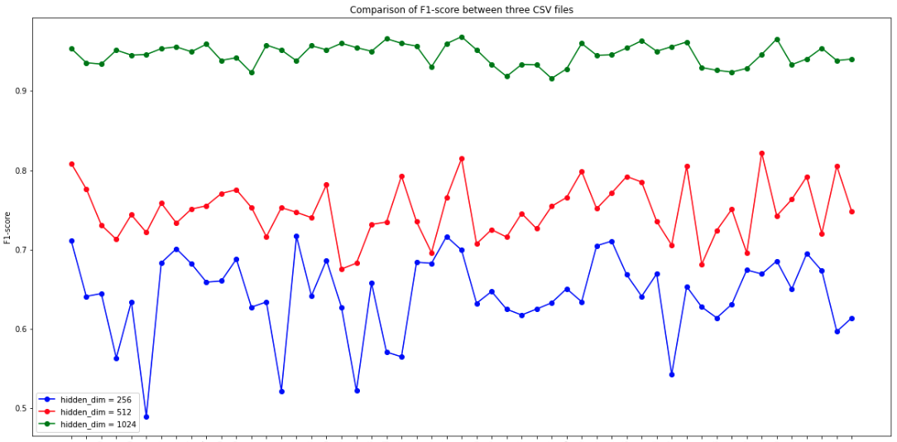
Oversampling
Previous Trial: hope to see the result on training dataset
Use data with 320 times single triplet → # of training data = 13657600
Larger hidden dimension → more neurons to remember the data
Let the model overfit first → Succeed

Slide 5
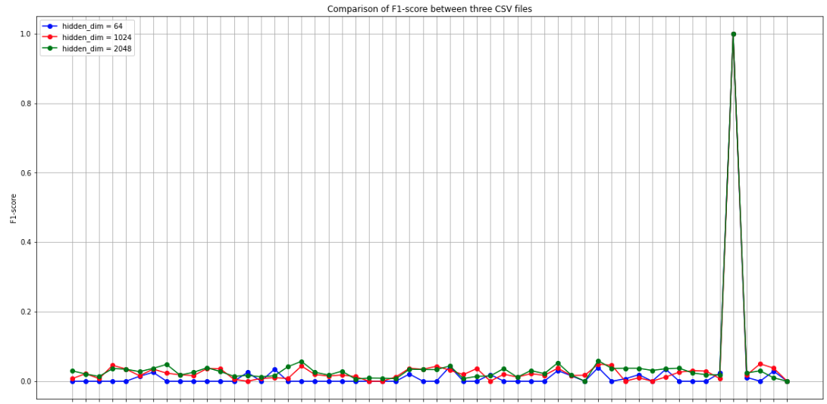
Observation on Different Dimension
T1518_c9b…

Slide 6
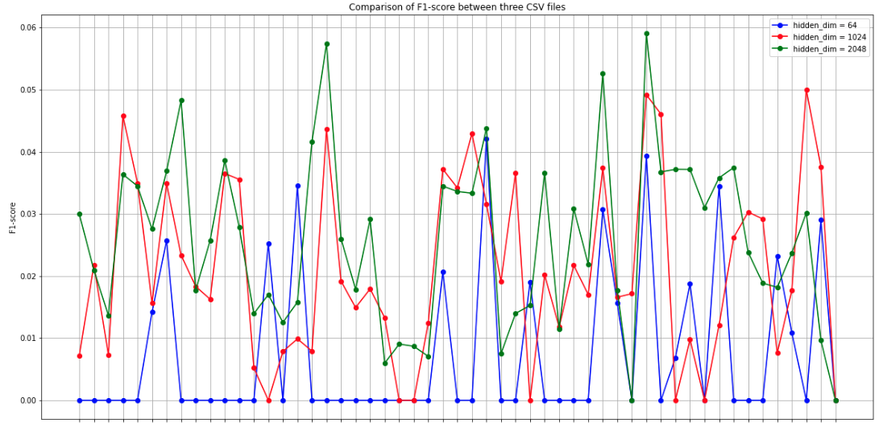
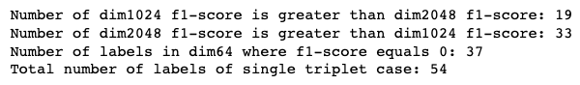
Observation on Different Dimension

Slide 7
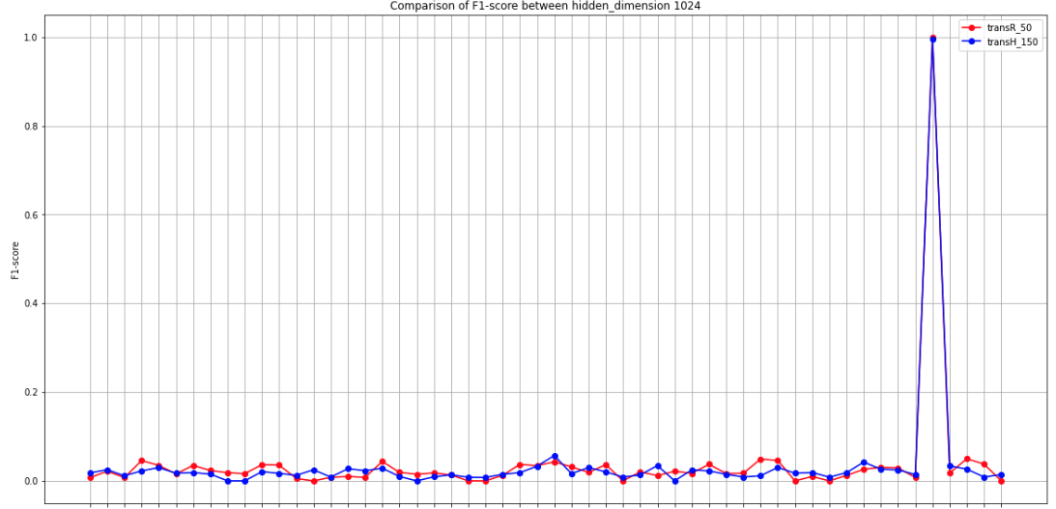
Observation on Different Embedding

Slide 8
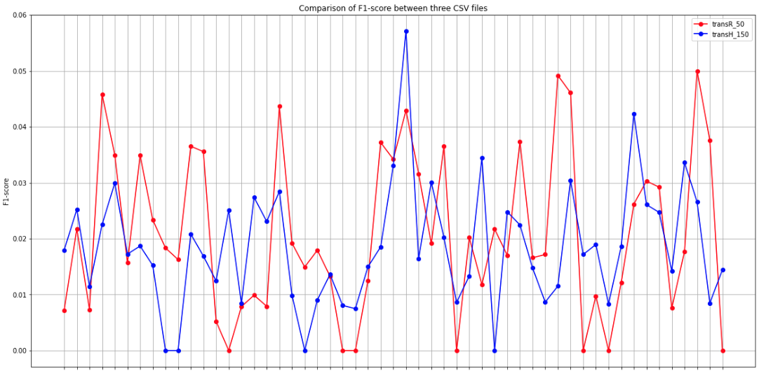
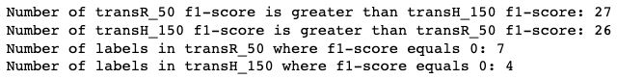
Observation on Different Embedding

Slide 9
Conclusion
Noticed that T1518_c9b always got predicted in all the experiments
Hidden Dimension do have an effect on the result → but it’s all about from 0 to 0.05
Embedding (transR_50 and tansH_150) seems to have the similar result → try more

Slide 10
Experiment - Observe

Slide 11
Thoughts
Try the ensemble
Different GNN
Different hidden dimension
Different embedding
Different model
Different type of model → MLP, RNN, GNN…
Maybe the different can identify the different single triplet class

Slide 12
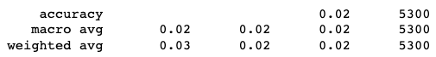
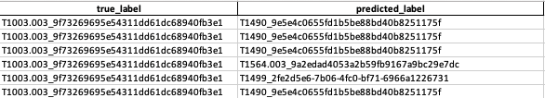
Ensemble - Voting
Noticed that T1518_c9b always got predicted in all the experiments
Euni’s MLP and RNN also predict T1518_c9b perfectly → Reason ?!
Experiment result on the single triplet case:
Voting these three models (MLP, RNN, GNN) may not be useful
Since the order of the prediction would be the same

Slide 13
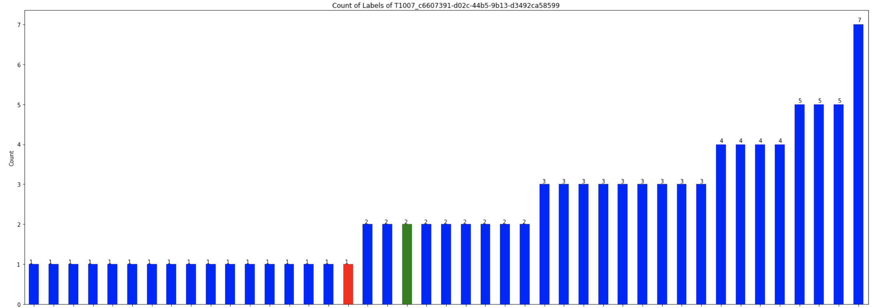
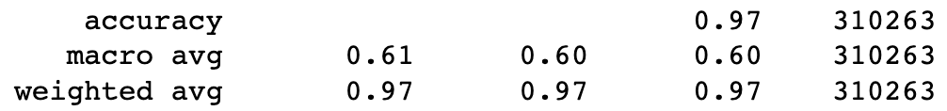
Observation of the Prediction
Use the original training set
The distribution of the prediction is so sparse
Most of the predictions are like this:
Red: non-single triplet edge
Blue: single triplet edge
Green: itself

Slide 14
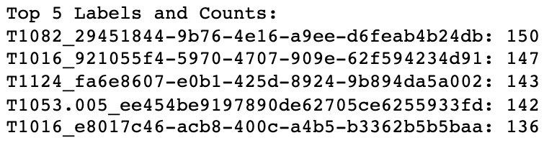
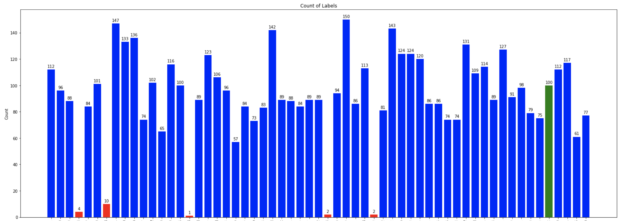
Observation of the Prediction
The # of the predicted labels
T1016
T1047
T1518_c9b (well predicted one)
T1490

Slide 15
Experiment - Remove

Slide 16
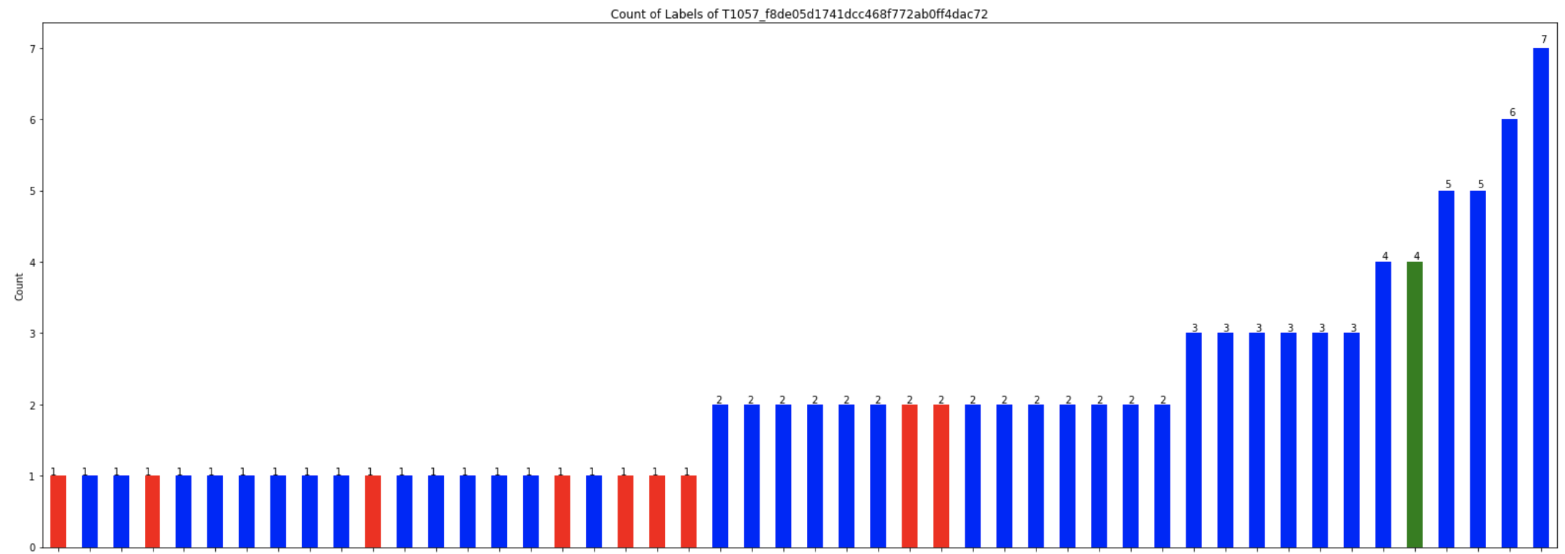
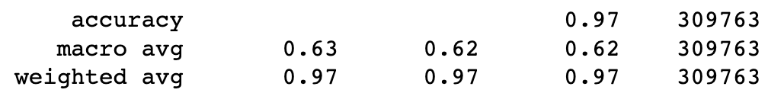
Remove the Popular TTPs
Remove these 5 TTPs from the dataset and then train it again:
More prediction on the non-single triplet case is like this:

Slide 17
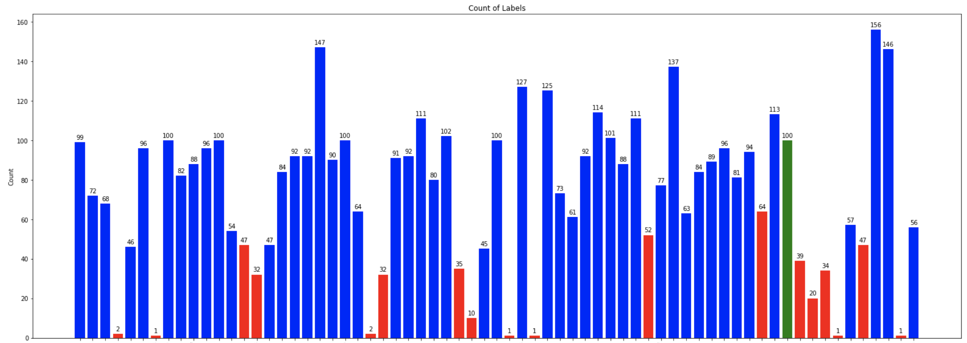
Remove the Popular TTPs
Remove these 5 TTPs from the dataset and then train it again:
The # of the predicted labels

Slide 18
GNN - Paper

Slide 19
GraphSMOTE: Imbalanced Node Classification on Graphs with Graph Neural Networks
WSDM ’21, March 8–12, 2021, Virtual Event, Israel
Tianxiang Zhao, Xiang Zhang, Suhang Wang
{tkz5084,xzz89,szw494}@psu.edu College of Information Science and Technology, Penn State University State College, The USA
https://github.com/TianxiangZhao/GraphSmote
Notes:
Arxiv 引用 190
WSDM 引用193
https://scholar.google.com.tw/scholar?q=Tianxiang+Zhao,+Xiang+Zhang,+Suhang+Wang&hl=zh-TW&as_sdt=0&as_vis=1&oi=scholar

Slide 20



Tianxiang Zhao
PhD student in PSU
co-advised by Prof.Xiang Zhang and Prof.Suhang Wang.
https://scholar.google.com/citations?user=pXkPq3YAAAAJ&hl=en
Xiang Zhang
Associate Professor in PSU
Data Mining, Machine Learning and Big Data Analytics
https://ist.psu.edu/directory/xzz89
Suhang Wang
Associate Professor in PSU
Data Mining, Machine Learning and Social Media Mining
https://suhangwang.ist.psu.edu/

Slide 21
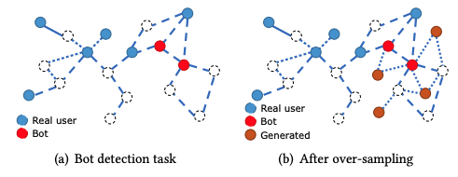
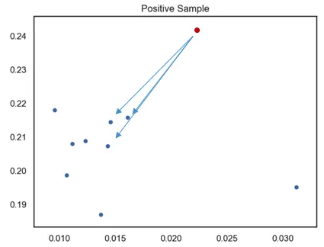
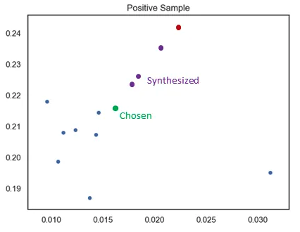
GraphSMOTE
Task:
Synthesized Minority Oversampling Technique (SMOTE)
Used on i.i.d. data
Doesn’t consider the structure of the graph
No edge connection between the nodes
K=3
N=3
Notes:
設定一個採樣倍率 N，也就是對每個樣本需要生成幾個合成樣本
設定一個近鄰值 K ，針對該樣本找出 K 個最近鄰樣本並從中隨機選一個
根據以下公式來創造 N 個樣本

Slide 22
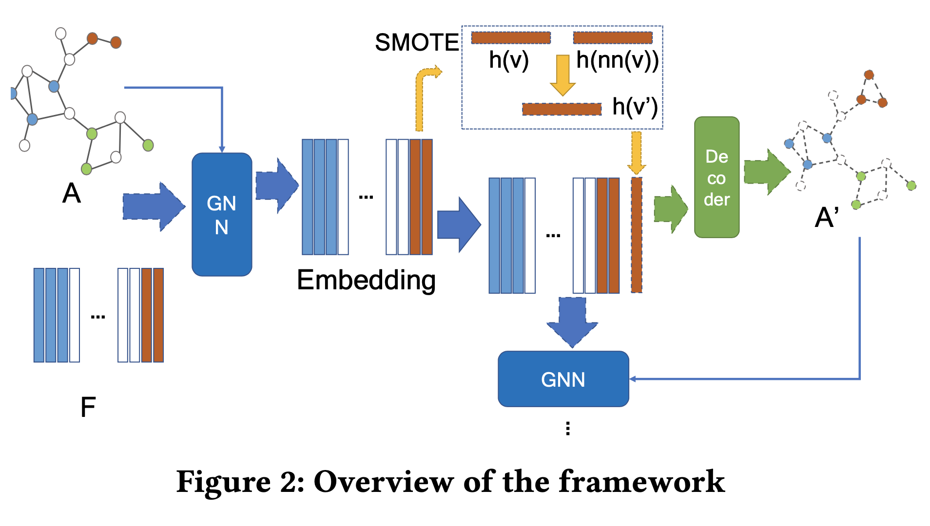
GraphSMOTE
Framework
a GNN-based feature extractor
→ Use GraphSAGE
Synthetic Node Generation
→ Use SMOTE algorithm
Edge Generator
→ weighted inner product decoder
GNN Classifier (downstream task)
Notes:
設定一個採樣倍率 N，也就是對每個樣本需要生成幾個合成樣本
設定一個近鄰值 K ，針對該樣本找出 K 個最近鄰樣本並從中隨機選一個
根據以下公式來創造 N 個樣本

Slide 23
Future Work

Slide 24
Future Work
GNN
Try some other methods to improve the performance of single triplet issue
Figure out why the model can detect the T1518_c9b (if available?)
Read the GraphSMOTE paper

Slide 25
Thanks!!

Slide 26
Appendix

Slide 27
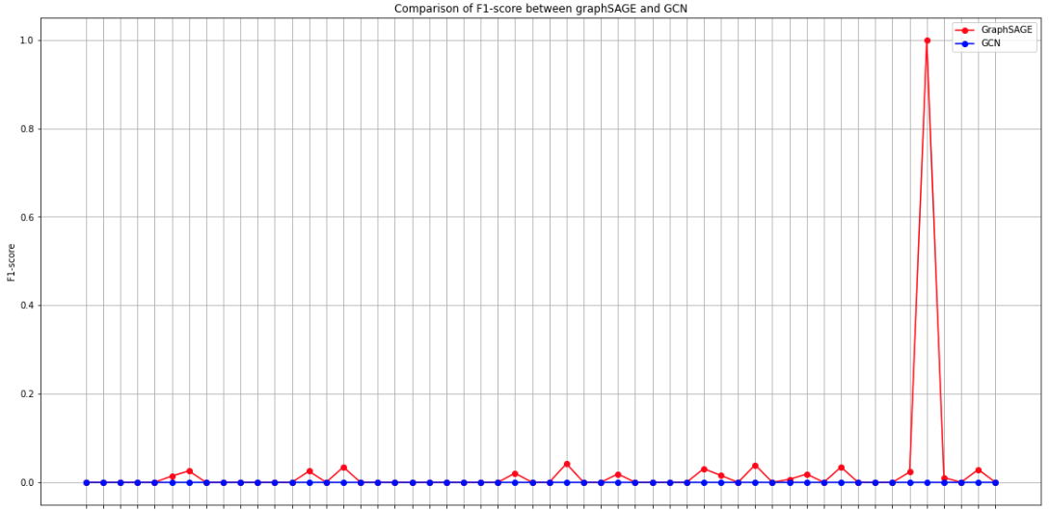
Observation on Different Model

Slide 28
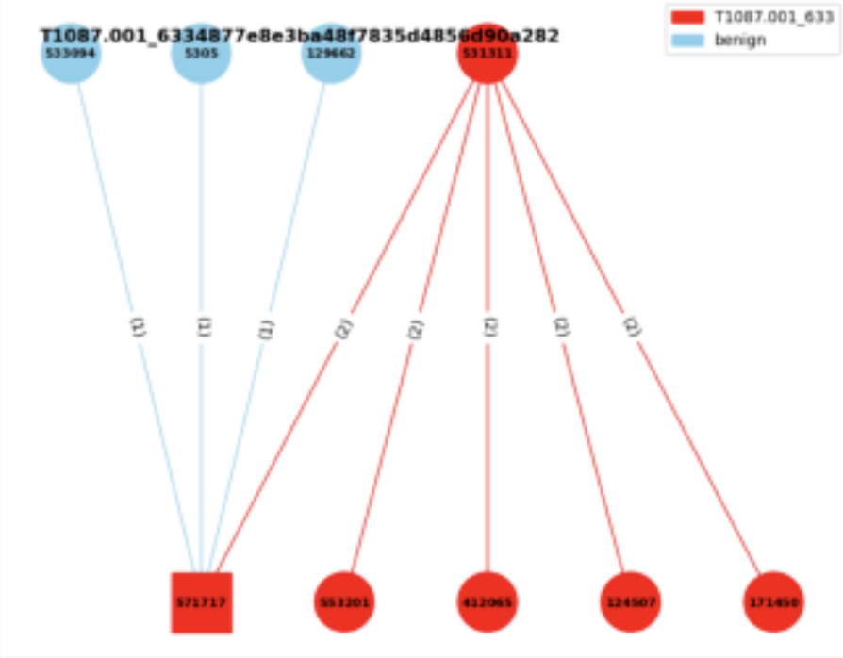
Experiment 3
Experiment 3:
Consider the neighbor benign nodes
Edge classification
Given a graph → label the triplets
with the benign or the specific AP
benign
T1003.001

Slide 29
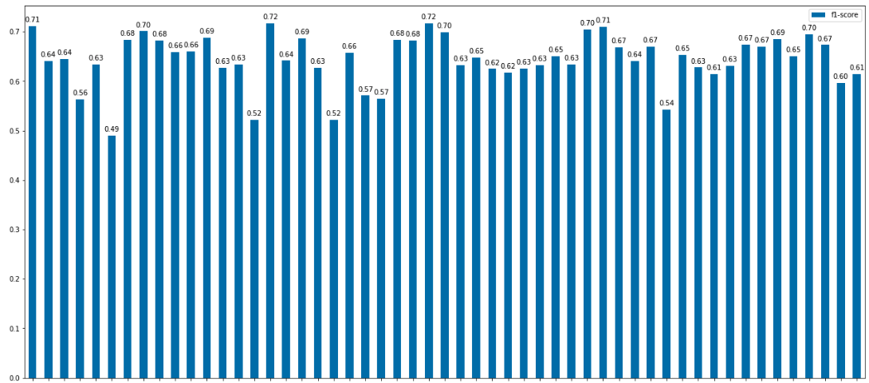
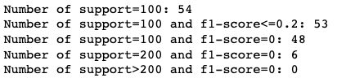
Experiment 3 - Oversampling
Bar Chart of hidden dimension = 256:

Slide 30
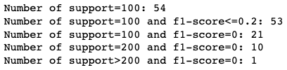
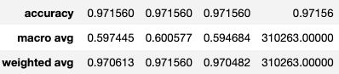
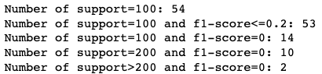
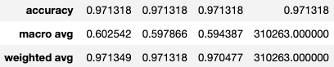
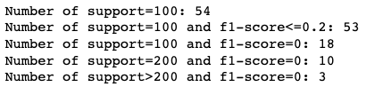
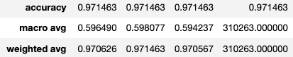
Experiment 3 - Oversampling
Current Trial: Duplicate the data with single triplets → 20, 40, 80, 320 times
20 times
40 times
80 times

Slide 31
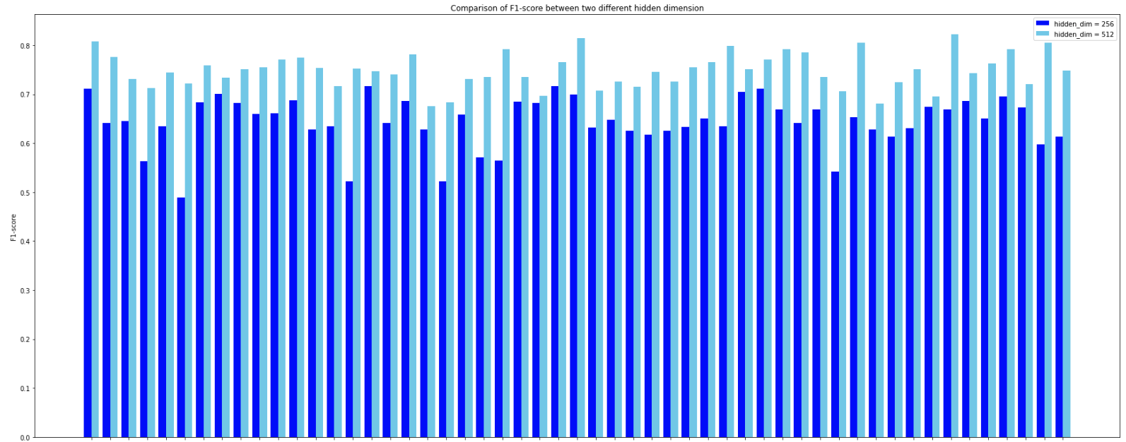
Experiment 3 - Oversampling

Slide 32
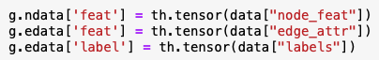
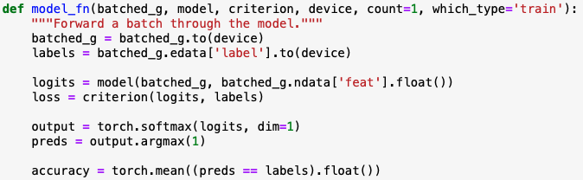
Experiment 3 - Model
Concept from the DGL official website:
Let the dgl graph’s edge data have the attribute: edata[“label”]
Use GraphSAGE model to get the new node embedding
Use MLP model to get the score of the edge
Concatenate these two models
Train the final model

Slide 33
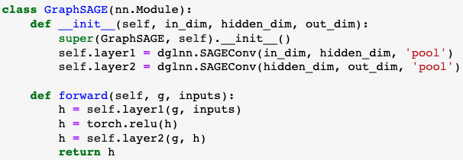
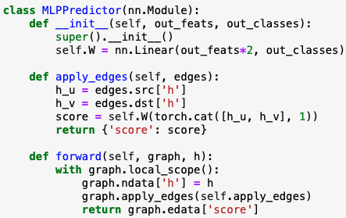
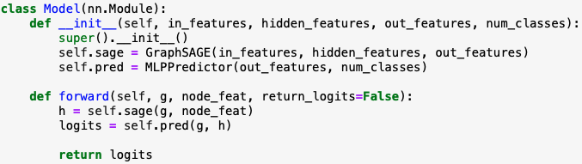
Experiment 3 - Model
Notes:
這個`MLPPredictor`模型是用於邊預測或稱為鏈接預測的。鏈接預測的目的是預測兩個節點之間是否存在邊。這是圖學習中的一個重要任務，被應用於許多領域，例如社交網絡中的好友推薦或蛋白質互作網絡的互作預測。
1. **初始化 (`__init__` 方法)**:
- 定義一個全連接線性層`self.W`，其輸入特徵的大小是 `in_features * 2`。這是因為我們將來源節點`h_u`和目標節點`h_v`的表示向量拼接起來，所以尺寸變為雙倍。
- 輸出的尺寸是 `out_classes`，這對應於邊的類別數量。
2. **apply_edges 方法**:
- 這個方法的作用是為圖中的每一條邊計算一個'score'。這個'score'可以被解釋為邊的類別。
- 它首先從圖中提取來源節點`h_u`和目標節點`h_v`的表示向量。
- 接著，它將這兩個表示向量拼接起來，並通過`self.W`線性層計算'score'。
3. **前向方法 (`forward`)**:
- 接收一個圖和它的節點表示`h`。
- 它將這些節點表示設定為圖的節點數據。
- 使用`apply_edges`方法為圖中的每一條邊計算一個'score'。
- 返回邊的'score'。
總之，`MLPPredictor`使用來源和目標節點的表示計算圖中每一條邊的'score'，這些'score'可以用於邊的預測任務。

Slide 34
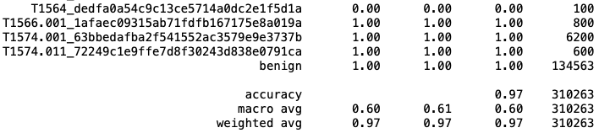
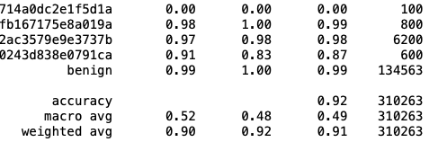
Experiment 3 - Result
Format of the edge labels:
Label 65 is benign
Classification report:
transR_50:
secureBERT_50:
Macro average is similar to previous experiments → won’t be affected by benign
Weighted average is very high since the # of the benign is high(unbalanced) and predictable
TransX family performs better than secureBERT

Slide 35
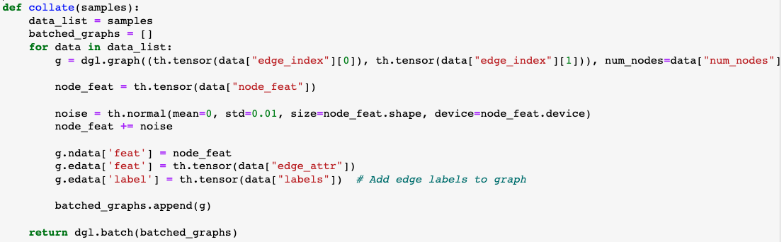
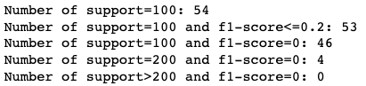
Experiment 3 – Noise
Current Trial 1:
Add the noise to the node feature

Slide 36
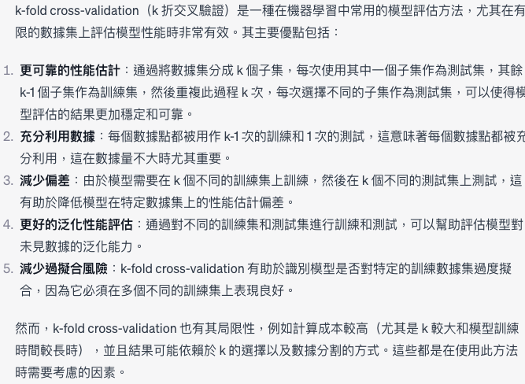
Experiment 3 – K-fold validation

